Slide 1

We care Home Care
Under The Guidance Of
Dr. Priya Swaminarayan
Developed By
Vrunda Savaliya(190511201741)
Submitted To:
Department of MCA
Faculty of IT & Computer Science,
PARUL University

Slide 2
Index
Project Profile
Requirement Analysis
Design
Implementation
Testing
Future Enhancement
Bibliography

Slide 3
Project Profile
Project Definition :
We care Home Care
Project Description :
A web-based solution to order/manage home care services (office/home cleaning, washing of rental house, stair cleaning etc.). The customer area should provide online ordering facility of home care services to end user along with management of his/her profile & orders. The admin area should provide easy way to manage customer, services, feedbacks & orders

Slide 4
Project Profile
Existing System :
There are some limitation in existing system in that system people can get only single provider which provide all type of services. They cannot get various Providers in one portal.

Slide 5
Project Profile
Problem Statements :
The Problem is people face difficulty to find particular cleaner in their area. Because they find cleaner offline and so that they cannot find the best cleaner.
Apart from this sometime they have to pay more money than the actual requirement. In addition they cannot get the more alternative options

Slide 6
Project Profile
Proposed System :
We care Home care is an exceedingly new system implementation that provide high-quality service that is affordable and flexible to our client.
Furthermore, people can book their service according to their requirement with any time at any place.
In addition, people can find the different alternatives of different services and they can get a chance to select based on their affordability

Slide 7
Project Profile
Scope :
The objective of the “WE CARE HOME CARE” is to develop a website so that the users can interact with the system and as per their needs they can hire professionals to avail the services provided by them.
Home services are needed and the demand for services is increasing everyday.
So to provide easy availability to users as well as service provider this system is very useful

Slide 8
Project Profile
Outcomes :
The objective of the “WE CARE HOME CARE” is to develop a website so that the users can interact with the system and as per their needs they can hire professionals to avail the services provided by them.
This project provides a system which can be utilized by the parties interested in hiring professionals for various house cleaning services and other miscellaneous day to day activities by listing all the available service providers nearby and allowing the user to select one that suits their interest.
Users don’t need to worry as all the profiles of service provider that appears on the application is pre-verified.
Users can select particular service provider by checking feedbacks and reviews provided by the customers.

Slide 9
Project Profile
8. Tools & Technology :
Tools :
Visual studio code
Postgresql server
Postman
Dbever

Slide 10
Project Profile
Technology :
Front End:
React :
React is an open-source, front end, JavaScript library for building user interfaces or UI components. It is maintained by Facebook and a community of individual developers and companies. React can be used as a base in the development of single-page or mobile applications
.
B. Back End:
Node:
Node.js is an open-source, cross-platform, back-end JavaScript runtime environment that runs on the V8 engine and execute
JavaScript code outside a web browser

Slide 11
Requirement Analysis
1. Feasibility Study :
There are different types of feasibility study.
I. Technical Feasibility :
This application does require that much of higher & advanced technology. It requires database interaction and it also requires to be accessed via any browser and also required internet on that particular device. This can be easily done. Also these should be a facility of online order for particular service online. We are sending all the service information with the all service attributes so the members can have reliable navigation and make proper decision for order service.

Slide 12
Requirement Analysis
Economical Feasibility :
In This project, we will require to have a internet connection for better online application. Such at the developer end it needs the good server with high capacity of RAM and CPU processors so can it can handle lots of members at time online communications, but as it will be web-enabled we do not have any extra cost of setting up a network. This is also feasible economically.
Operational Feasibility :
The new system can be beneficial only if it satisfies the organization requirements; in such a way that resource utilization and optimum outcome is justified. A new system should not only be robust but should also be able to work simultaneously with other systems. Operational feasibility means that new system should not affect any existing system during the development phase or even in the implementation phase.

Slide 13
Requirement Analysis
Users of the System :
Admin
Customer
Provider

Slide 14
Requirement Analysis
Modules of the System :
Login
Registration
Customer Management
Provider Management
Order Management
Service Management
Feedback Management

Slide 15
Requirement Analysis
Hardware & Software Requirement :
Developer end :
Software Requirement :
Visual Studio code
Postman
Dbever
Web Browser(Mozilla Firefox,Google Chrome)
MS Word
MS Power Point
E-Draw
Hardware Requirement :
Processor - Intel Core i5 6th Gen
Memory – 4.00 Gb
OS(Window 10)
Hard disk(1.00 Tb)

Slide 16
Requirement Analysis
User end :
Internet enabled device with web-browser

Slide 17
Requirement Analysis
Use Cases :
Admin :
Actions :
Login
Manage service
Manage subservices
Manage Provider
Manage Feedback
Manage customer

Slide 18
Requirement Analysis
User :
Actions :
Login/Register
View Services and sbservices
Give Feedback
Make Order
View Order

Slide 19
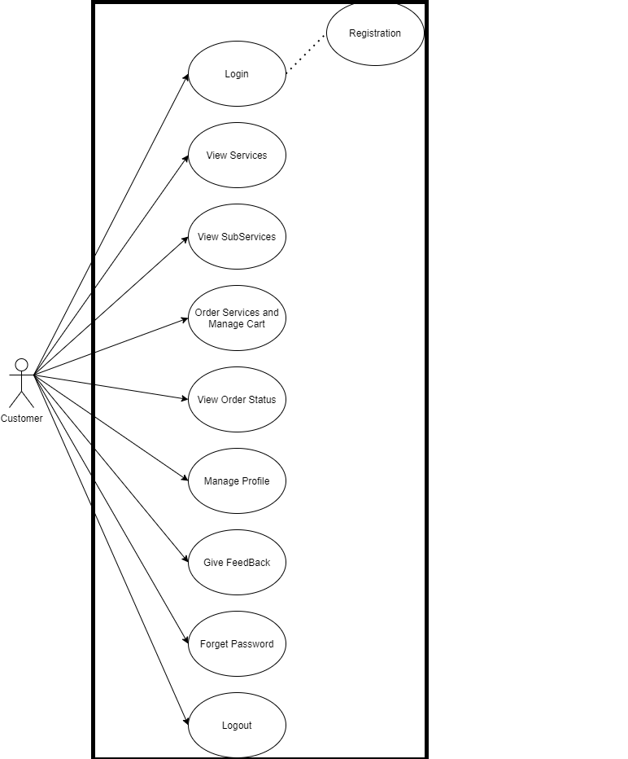
Requirement Analysis
Use Case Diagram :
Customer:

Slide 20
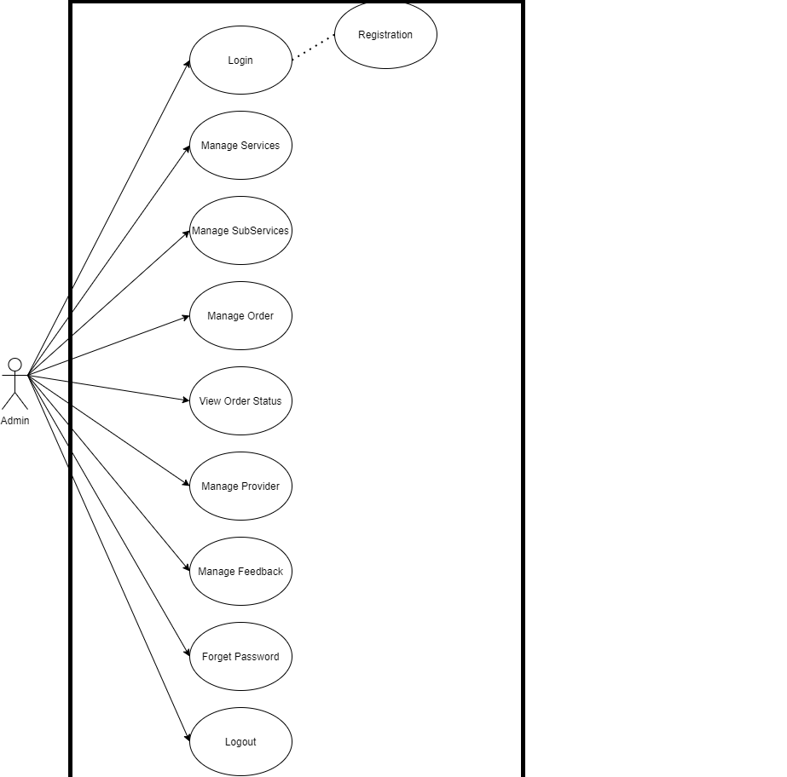
Requirement Analysis
Admin :

Slide 21
Design
Use Case Scenario :
Admin Login :
Use Case ID | UC01
Use Case Name | Login
Primary Actor | Admin
Pre-Condition | Admin must be registered
Basic Flow Of System | The website can be accessed through email id and password
Alternative Way | There is not any alternative way for login

Slide 22
Design
Manage Provider :
Use Case ID | UC02
Use Case Name | Manage Provider
Primary Actor | Admin
Pre-Condition | Admin must be logged in
Basic Flow Of System | Admin can add Provider, update the provider details and delete the provider
Alternative Way | There is not any alternative way for login
III. View Customer
Use Case ID | UC03
Use Case Name | View Customer
Primary Actor | Admin
Pre-Condition | Admin must be logged in
Basic Flow Of System | Admin can view all the customer which are enroll in this website
Alternative Way | There is not any alternative way for login

Slide 23
Design
IV. Manage Order
Use Case ID | UC04
Use Case Name | Manage Order
Primary Actor | Admin
Pre-Condition | Admin must be logged in
Basic Flow Of System | Admin can view order, confirm and reject the order and also view the status of the order
Alternative Way | There is not any alternative way for login
V. Manage Feedback
Use Case ID | UC05
Use Case Name | Manage Feedback
Primary Actor | Admin
Pre-Condition | Admin must be logged in
Basic Flow Of System | Admin can view feedback ,give response of that particular feedback
Alternative Way | There is not any alternative way for login

Slide 24
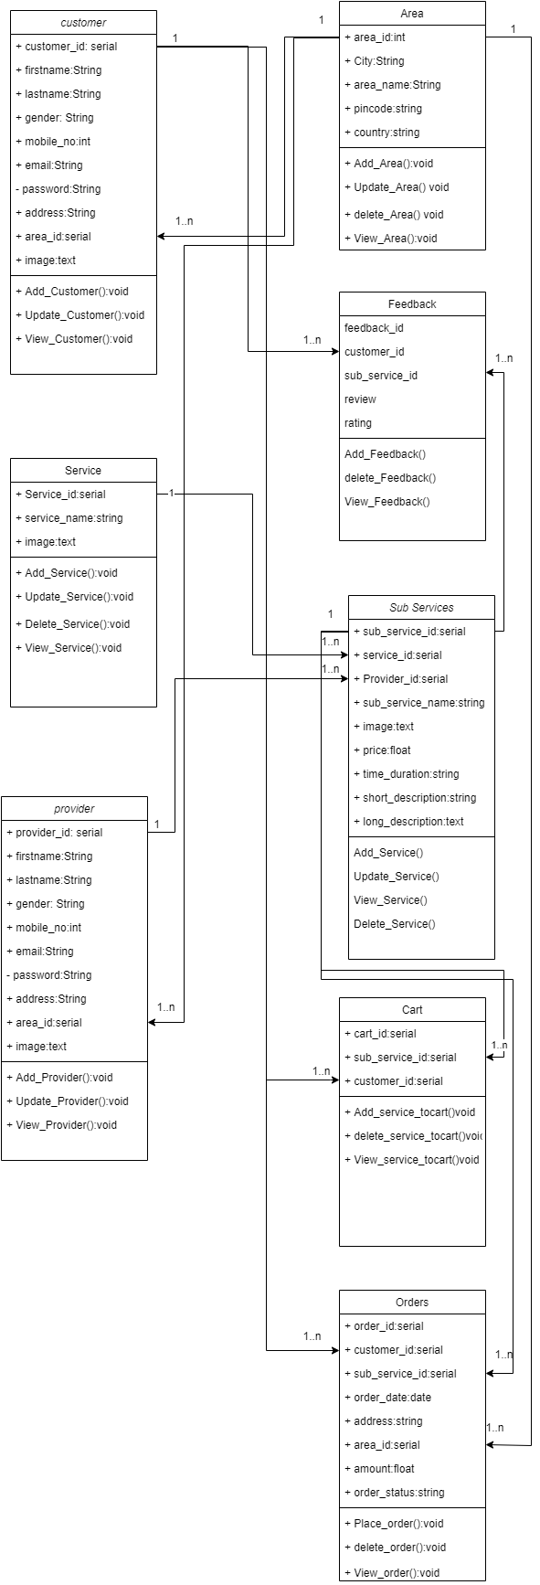
Design
UML Diagrams :
Class Diagram :

Slide 25
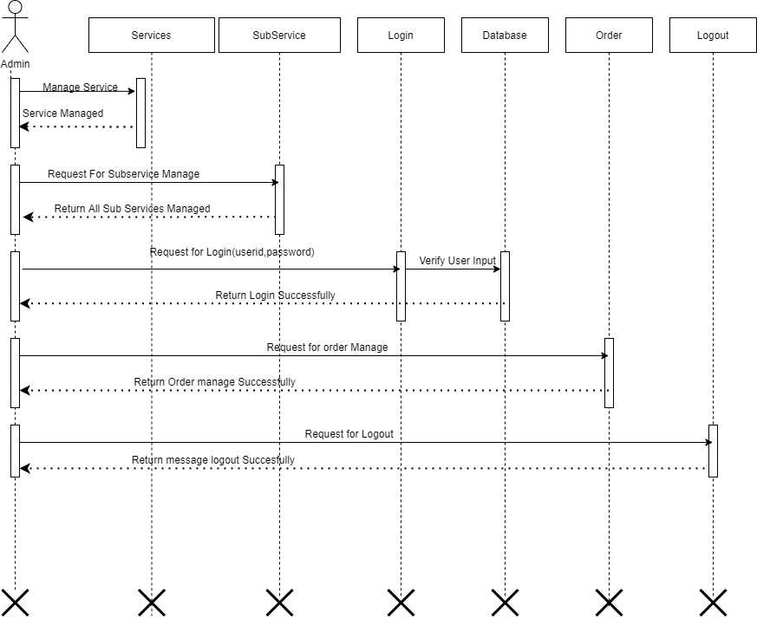
Design
Sequence Diagram :
Admin :

Slide 26
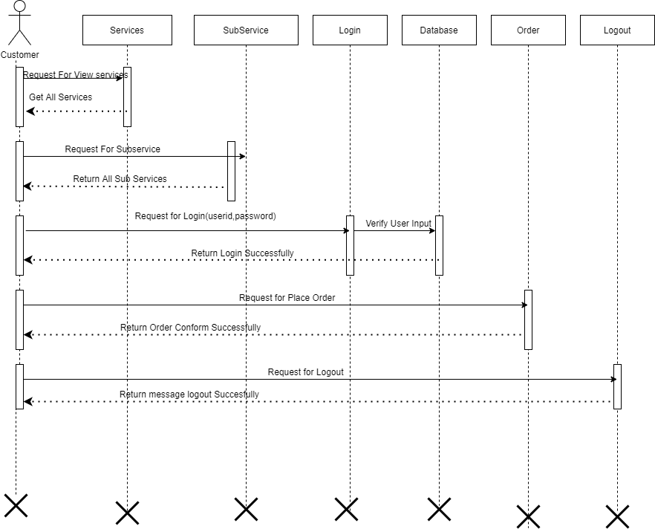
Design
User :

Slide 27
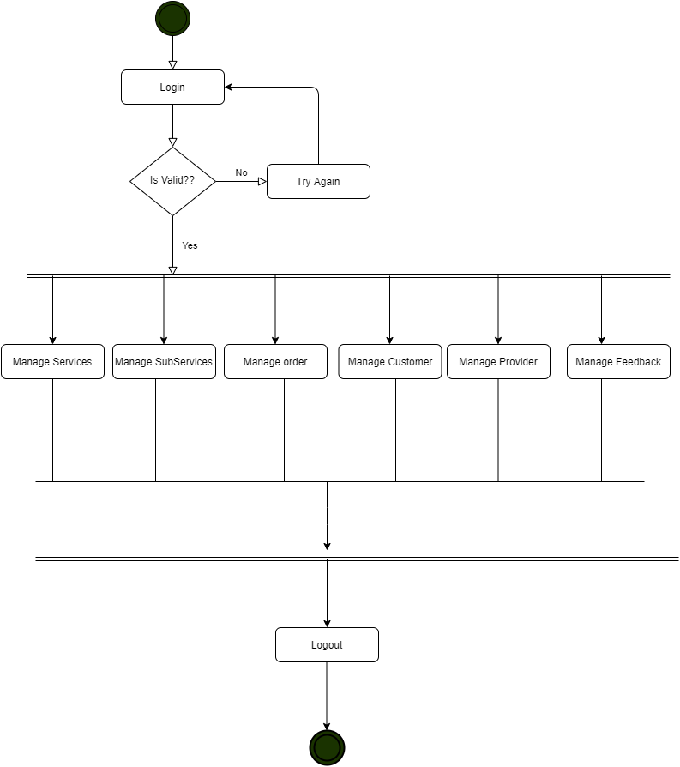
Design
Activity Diagram :
Admin :

Slide 28
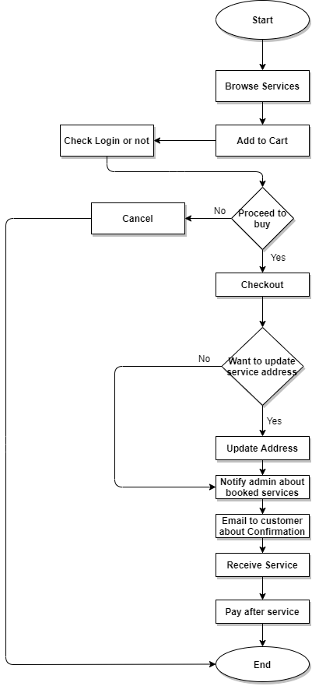
Design
User :

Slide 29
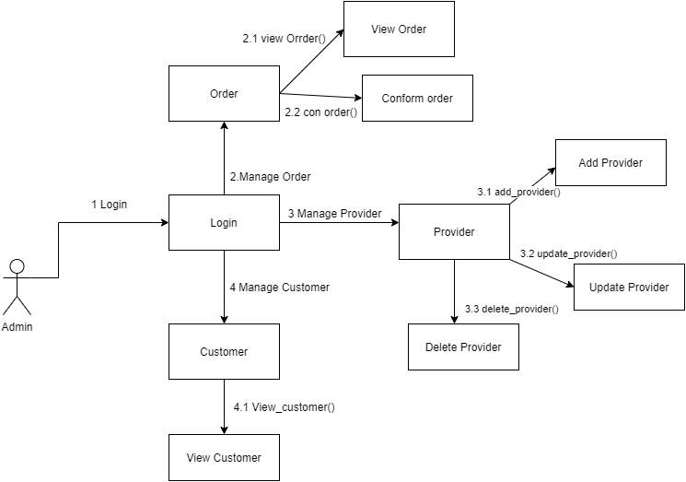
Design
Collaboration Diagram :
Admin :

Slide 30
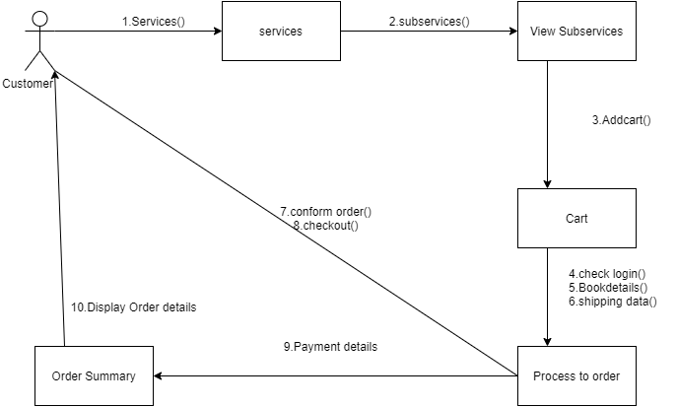
Design
User :
Wecarehomecare

Slide 31
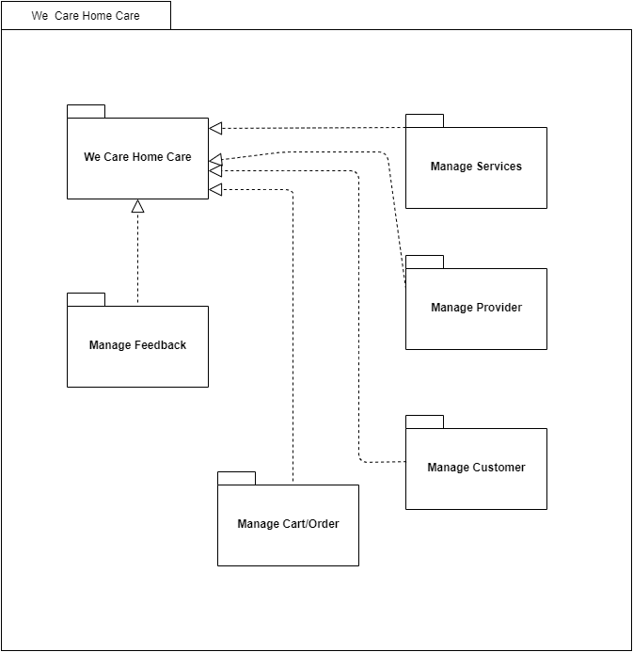
Design
Package Diagram :
Wecarehomecare

Slide 32
Design
3.3 Data Dictionary
1. Customer
Field | Data Type | Constraints | Description
ID | _{Alpha-Numeric} | Primary key | Store unique id of customer
Firstname | Text | Required | Store firstname of customer
lastname | Text | Required | Store lastname of customer
Gender | Text | Required | Store gender of customer
Mobileno | Float | Required | Store mobileno of customer
Email | Text | Required | Store email of customer
Password | Text | Required | Store password of customer
Address | Text | Required | Store address of customer
Image | Text | Required | Store image of customer
Area | Text | Required | Store area of customer
Created_date | Date | Required | Store date of customer registration
Modified_date | Date | Required | Store date of customer update their details

Slide 33
Design
Services:
Field | Data Type | Constraints | Description
ID | Alpha-Numeric | Primary key | Store unique id of Services
Service_name | Text | Required | Store service name
Image | Text | Required | Store image of service
Created_date | Date | Required | Store date
Modified_date | Date | Required | Store date of service update
3. Cart :
 | Data Type | Constraints | Description
ID | Alpha-Numeric | Primary key | Store unique id of cart
customer_id | Alpha-Numeric | Foreign key(customer)
subService_id | Alpha-Numeric | Foreign key(subservice)
Created_date | Date | Required | Store date
Modified_date | Date | Required | Store date of cart update

Slide 34
Design
4. PlaceOrder:
Field | Data Type | Constraints | Description
ID | Alpha-Numeric | Primary key | Store unique id of order
customer_id | Alpha-Numeric | Foreign key(customer)
subService_id | Alpha-Numeric | Foreign key(subservice)
Order_date | Date | Required | Store the order date
Address | Text | Required | Store deliver address
Area | Text | Required | Store area
Amount | Number | Required | Store price of service
Order_status | Text | Required | Store the order status
Created_date | Date | Required | Store date
Modified_date | Date | Required | Store date of order update

Slide 35
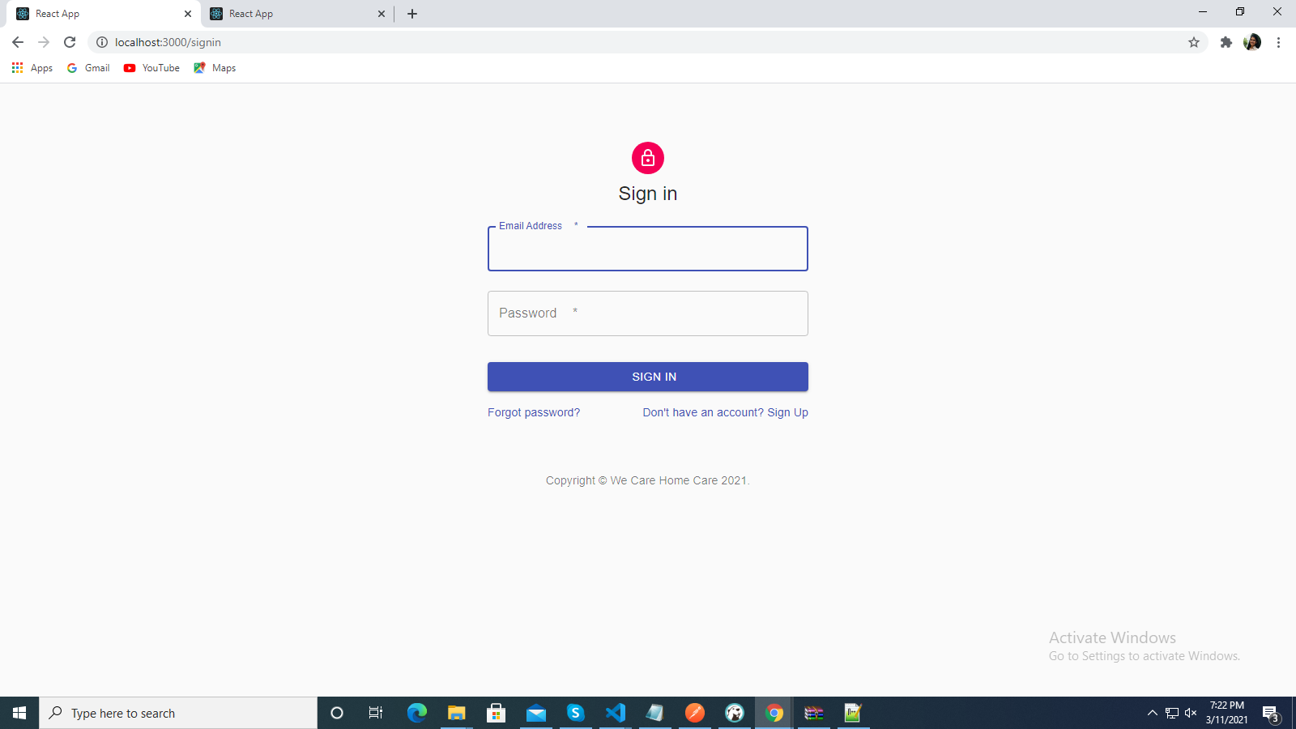
Implementation
Form Layouts :
1. Login :

Slide 36
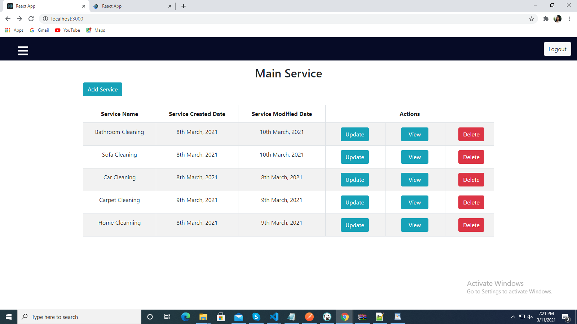
2. Admin Dashboard :
Wecarehomecare

Slide 37
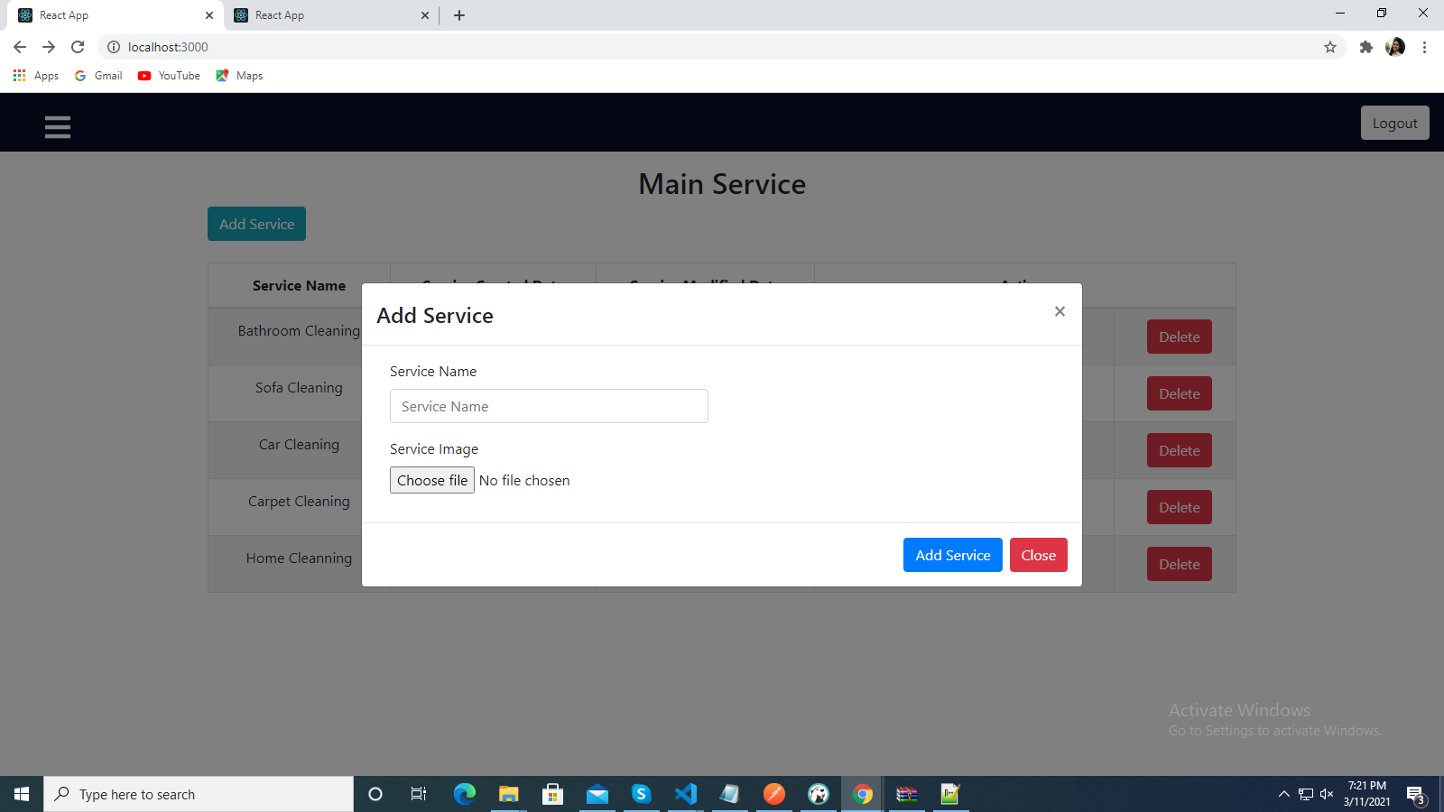
3. Add services
Wecarehomecare

Slide 38
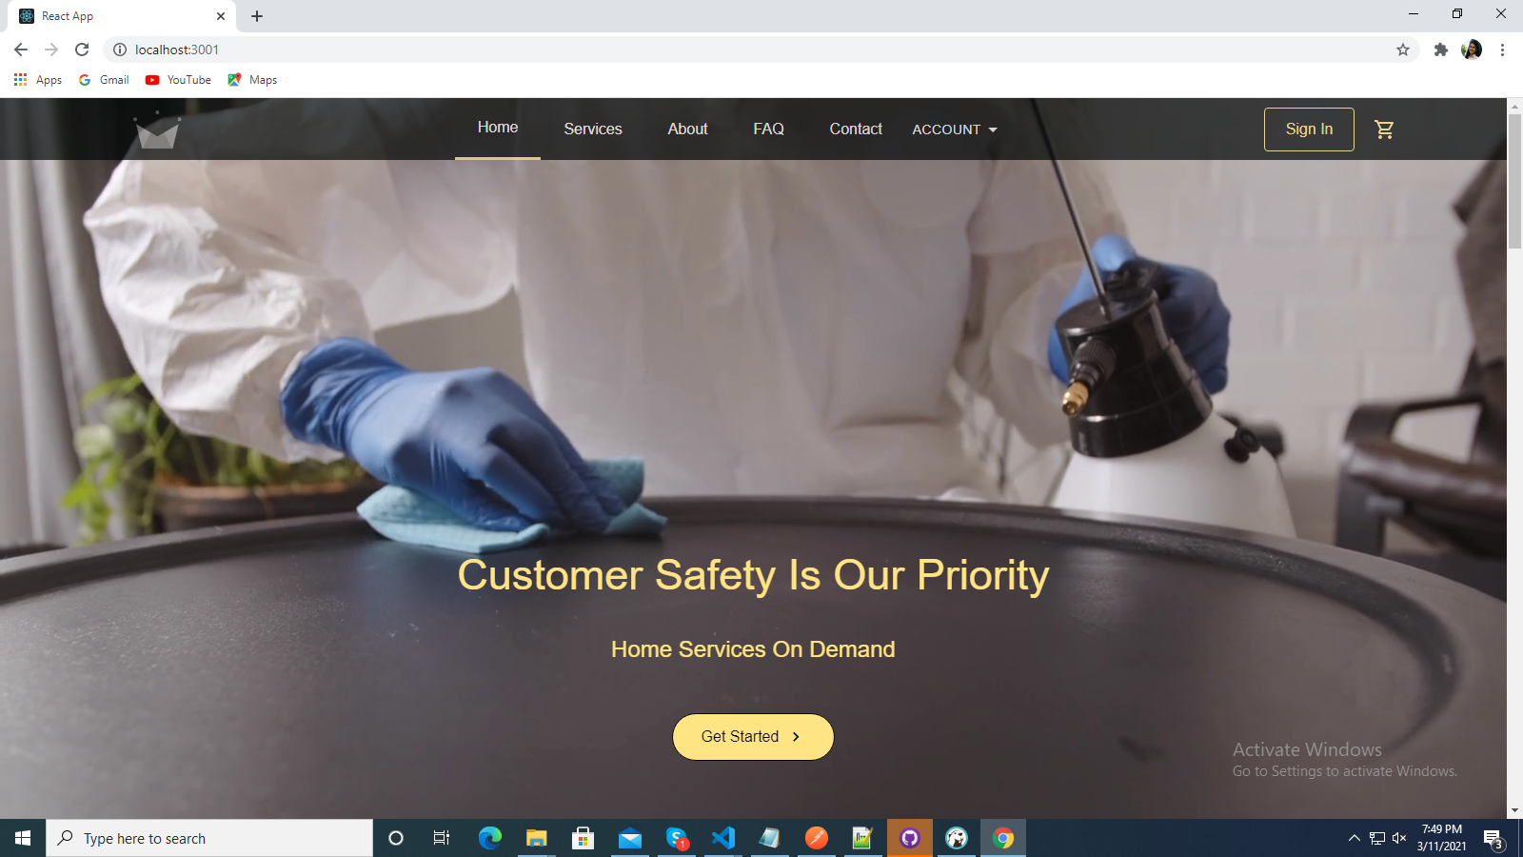
4. Customer Dashboard:
Wecarehomecare

Slide 39
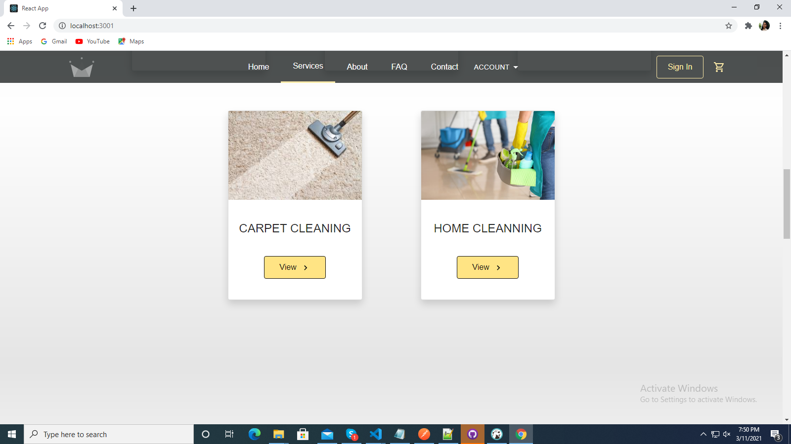
5. View Services on customer dashboard
Wecarehomecare

Slide 40
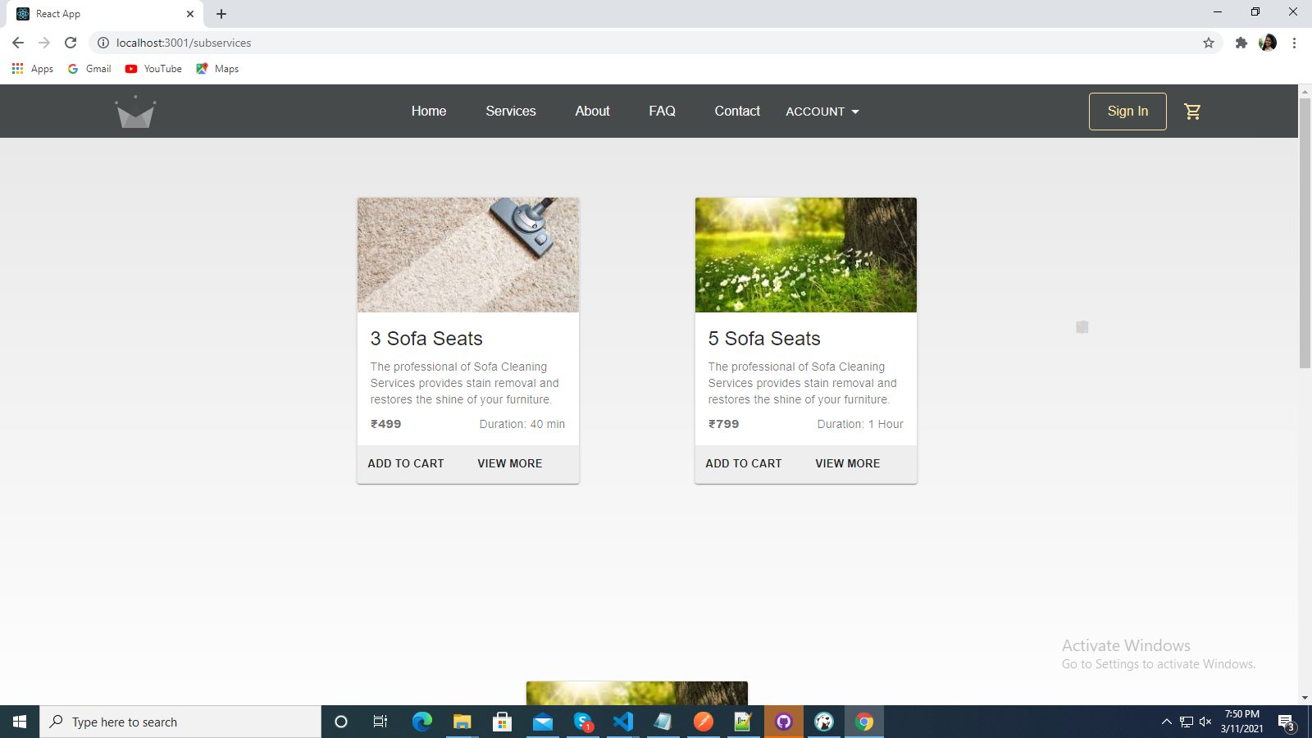
6. View Subservices
Wecarehomecare

Slide 41
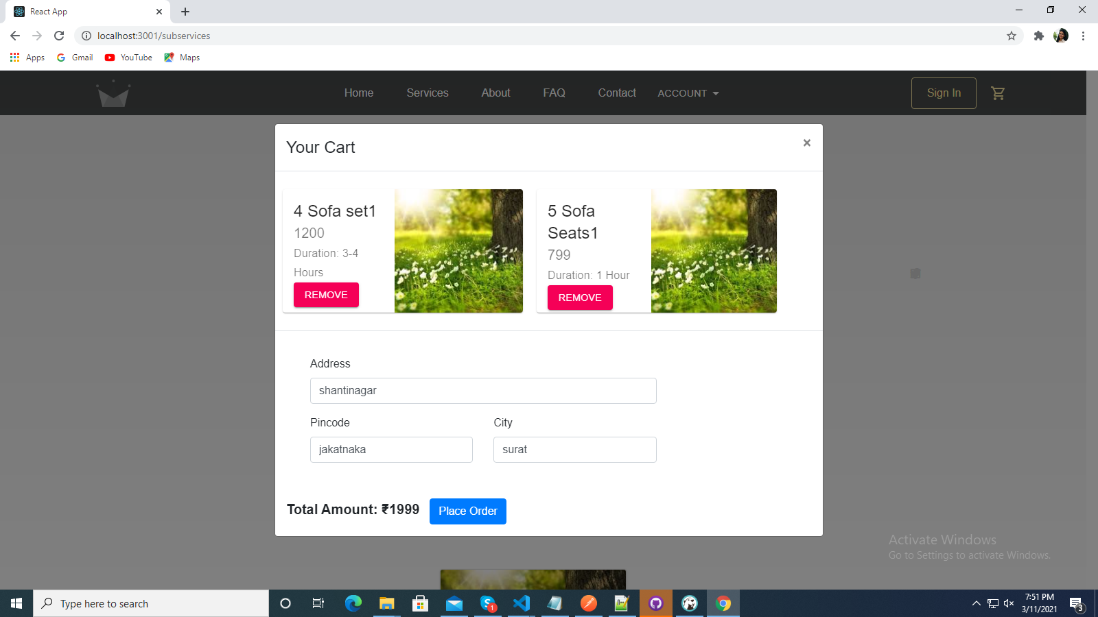
7. View cart
Wecarehomecare

Slide 42
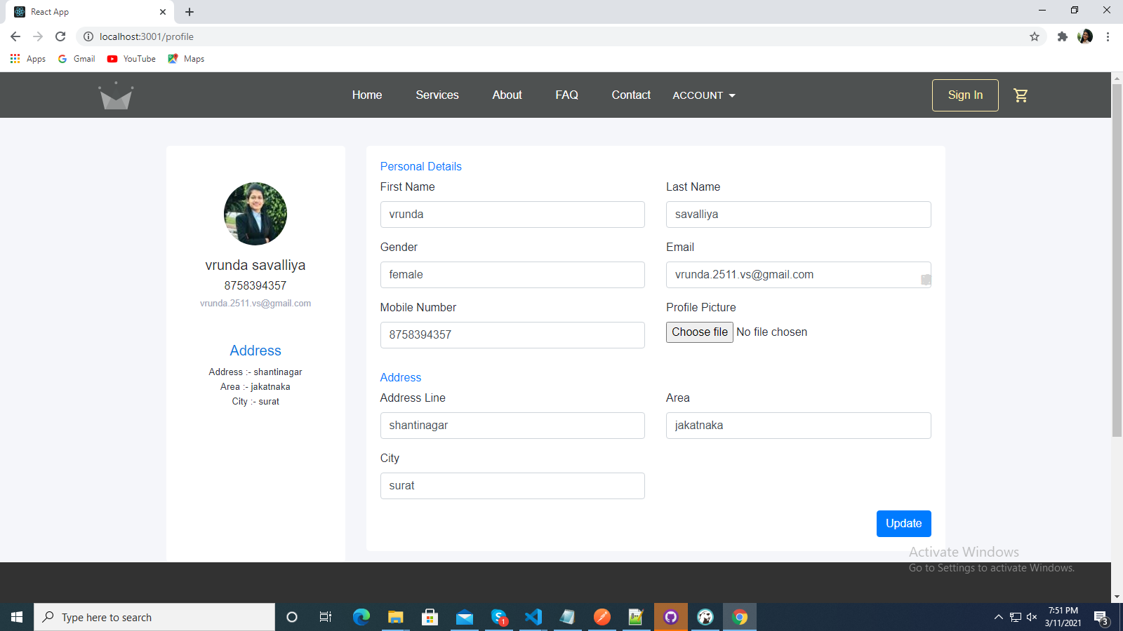
8. Customer ViewProfile:
Wecarehomecare

Slide 43
Testing
Test Strategy :
In our scenario test strategy is used to test the functionality of our system. We have to use to cover all scenarios. Main focus is on Functional Testing. In Functional Testing test case are used to test the application interface.
In our system testing is going to be done at individual module level. Each module will be undergone to Unit Testing and expected result is supposed to be same as actual result.

Slide 44
Test Cases :
Login :
Test Case ID | TC001
Test Case Summary | This test case was conducted for checking login.
Related Requirement | RS001
Prerequisite | Customer must be registered in system.
Test Procedure | Enter email and password. Check the email and password is correct or not. Click on login button.
Test Data | Email:vrunda@gmail.com Password: ********
Expected Result | Customer enters into the system.
Actual Result | Customer can view the customer Dashboard.
Status | Pass
Remarks | This test case is for login into the system.
Created By | Vrunda savaliya
Date of Creation | 10/03/2021
Executed By | Vrunda savaliya
Date of Execution | 10/03/2021
Test Environment | Chrome Browser

Slide 45
Add New Service :
Test Case ID | TC002
Test Case Summary | This test case was conducted for add new Service.
Related Requirement | RS002
Prerequisite | Admin must be logged-in in the system.
Test Procedure | Enter service Name, Select service File. Click on add service button.
Test Data | Service Name : Home Cleaning Service File: home.png
Expected Result | Added service in system.
Actual Result | Service added successfully.
Status | Pass
Remarks | This test case for add new service.
Created By | Vrunda savaliya
Date of Creation | 10/03/2021
Executed By | Vrunda savaliya
Date of Execution | 10/03/2021
Test Environment | Google Chrome

Slide 46
Add New Sub Services :
Test Case ID | TC003
Test Case Summary | This test case was conducted for add new Service.
Related Requirement | RS003
Prerequisite | Admin must be logged-in in the system.
Test Procedure | Enter subservice Name, Select subservice File, subservice price, subservice time duration, Click on add subservice button.
Test Data | Service Name : Home Cleaning Service File: home.png Price:1600 Timeduration:2-3 hours
Expected Result | Added subservice in system.
Actual Result | Subservice added successfully.
Status | Pass
Remarks | This test case for add new subservice.
Created By | Vrunda savaliya
Date of Creation | 10/03/2021
Executed By | Vrunda savaliya
Date of Execution | 10/03/2021
Test Environment | Google Chrome

Slide 47
Add New Provider:
Test Case ID | TC004
Test Case Summary | This test case was conducted for add Provider.
Related Requirement | RS004
Prerequisite | Admin must be logged-in in the system.
Test Procedure | Enter Provider Name, mobile no, gender, address, Click on add button.
Test Data | Providername: vrunda Mobileno:87678989 Gender: Female Address: shantinagar
Expected Result | Added Provider in system.
Actual Result | Provider added successfully.
Status | Pass
Remarks | This test case for add new provider.
Created By | Vrunda savaliya
Date of Creation | 10/03/2021
Executed By | Vrunda savaliya
Date of Execution | 10/03/2021
Test Environment | Google Chrome

Slide 48
Future Enhancement
In future I will provide Provider dashboard on that they can manage their own services and order directly
We will provide the Location services
We will provide the android application of this website

Slide 49
Thank You!!!

